Slide 1

CERTIFICATE COURSE PROGRESS REPORT

Slide 2

CONTENTS
01 Course Overview
02 Course Content and Modules
03 Progress and Reflection
04 Certification

Slide 3

COURSE OVERVIEW
COURSE TITLE AND DETAILS
Certificate Course Progress Report
Course: Web Development with HTML and CSS for Beginners
Platform: Alison
Name: Arjun Poovakkattel Saji
Date: 08.10.25

Slide 4

COURSE DESCRIPTION
COURSE INTRODUCTION
Introduces fundamentals of web development
Focus on HTML and CSS basics
Hands-on experience creating structured webpages
LEARNING OBJECTIVES
Understand HTML structure and elements
Learn CSS for effective styling
Create simple web pages and layouts
Apply formatting, colors, and fonts

Slide 5
COURSE CONTENT AND MODULES
HTML Basics
Core Topics
Tags, attributes, headings, paragraphs
Links, images, tables, and lists
CSS Basics
Styling Elements
Inline, internal, external styles
Properties: color, font, text-align, background-color

Slide 6

PROGRESS AND REFLECTION
COURSE PROGRESS SCREENSHOT
Visual Proof
Screenshot showing course completion or certificate page
Caption: “Course completed on Alison – Web Development with HTML and CSS for Beginners”

Slide 7

KEY LEARNINGS AND REFLECTION
SKILLS GAINED
Structuring webpages with HTML
Styling webpages with CSS (colors, fonts, layouts)
Completed hands-on mini projects or exercises
Distinction between HTML (structure) and CSS (styling)

Slide 8
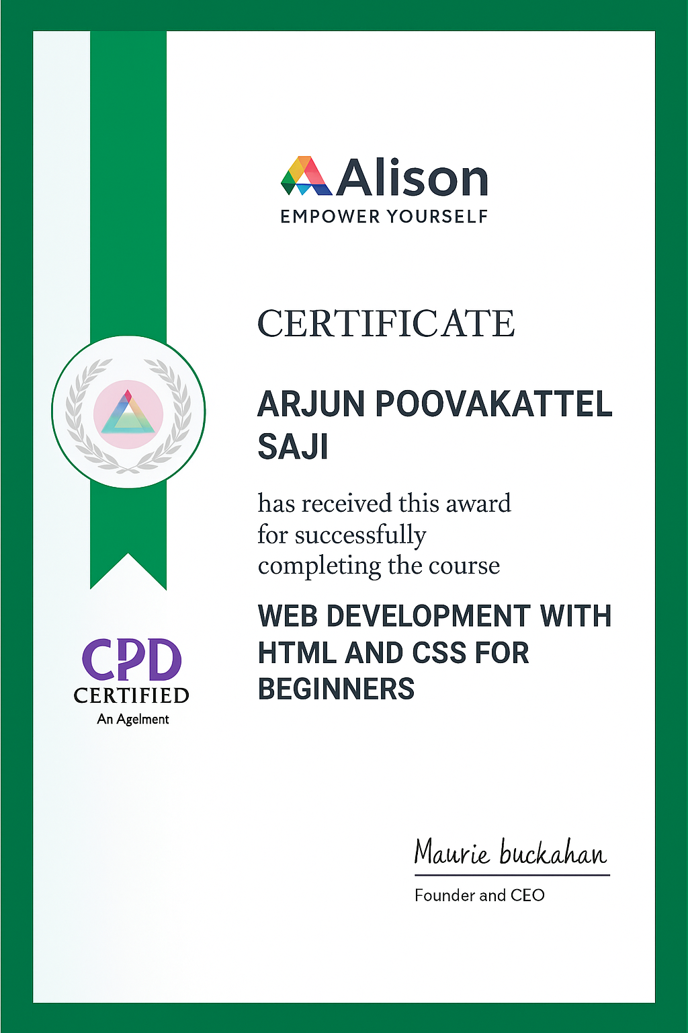
CERTIFICATE

Slide 9

THANK YOU

